Slide 1
Familiarize yourself with phishing attacks
<teams identified as most at risk>

Slide 2
What is phishing?
Phishing is a type of cyberattack where attackers disguise themselves as trustworthy sources in emails or messages to trick users into revealing sensitive information such as passwords, banking details, or personal data.
🧠 Key Traits:
Pretends to be someone you trust (boss, bank, IT)
Uses urgent or alarming language
Often includes fake links or malicious attachments

Slide 3
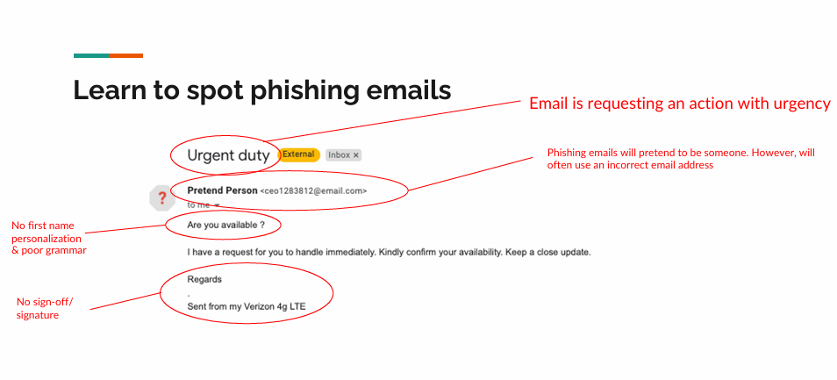

Slide 4
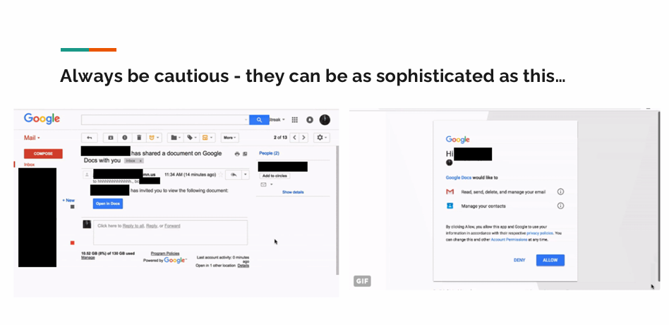

Slide 5
How to protect yourself
Never click on links or attachments you weren’t expecting
Hover over links to inspect the real URL
Contact the sender directly if you’re unsure
Enable multi-factor authentication (MFA)
Report suspicious emails to the IT/security team

